Slide 1

Multi-User Concepts
Miroslav Biňas
(c) 2010 - 2012
Notes:
35 min (2)

Slide 2
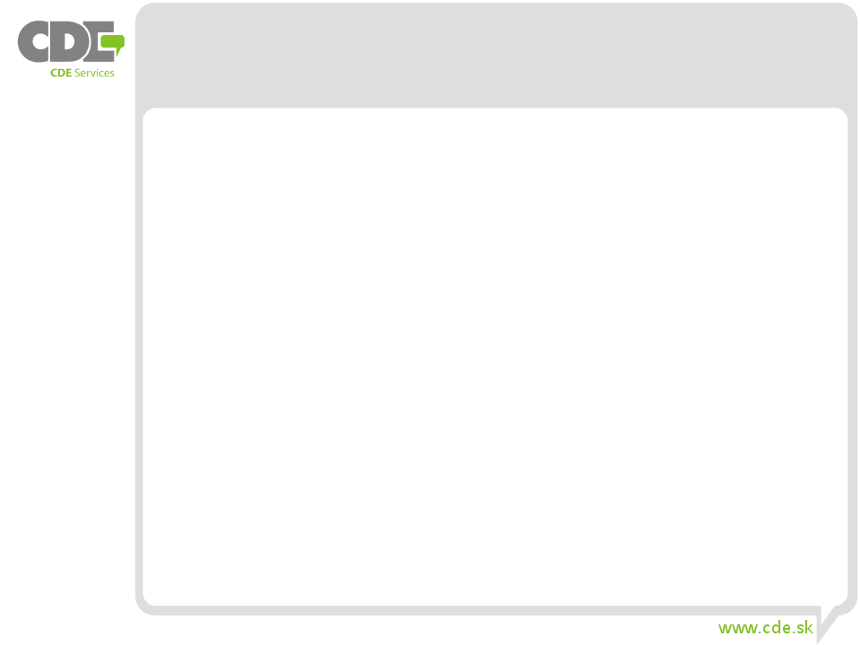

got root?
root – system superuser
root privileges – root can run anything and access to everything
can't read encrypted data, but can access to the
root account is locked in modern distributions (Ubuntu)
not only for security reasons
way to obtain root access through sudo command

Slide 3
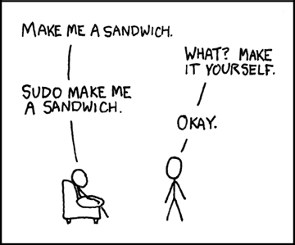
sudo Concept Explained ;)

Slide 4
Logging in
to log in, you have to provide your username and password
to log out, use command exit or press CTRL+D
change password with passwd command
/etc/passwd - list of users and user settings|
cat /etc/passwd | grep student | wc –l
who -q | grep student --count

Slide 5
Switching User Contexts I.
useful for quick actions without the need to log off and log back in
su command is used to become another user or superuser during login session
syntax: $ su [OPTIONS] [USER]
if no user is provided, su defaults become superuser
- option provides similar environment to what the user would expect, when user logs in directly

Slide 6
Switching User Contexts II.
sudo – allows limited administrative access
no need to know root's password
executes command as another user (superuser)
syntax: $ sudo command
based on configuration in /etc/sudoers
Before we start … centos 7
date
Timedatectl
timedatectl list-timezones
sudo timedatectl set-timezone Europe/Bratislava

Slide 7
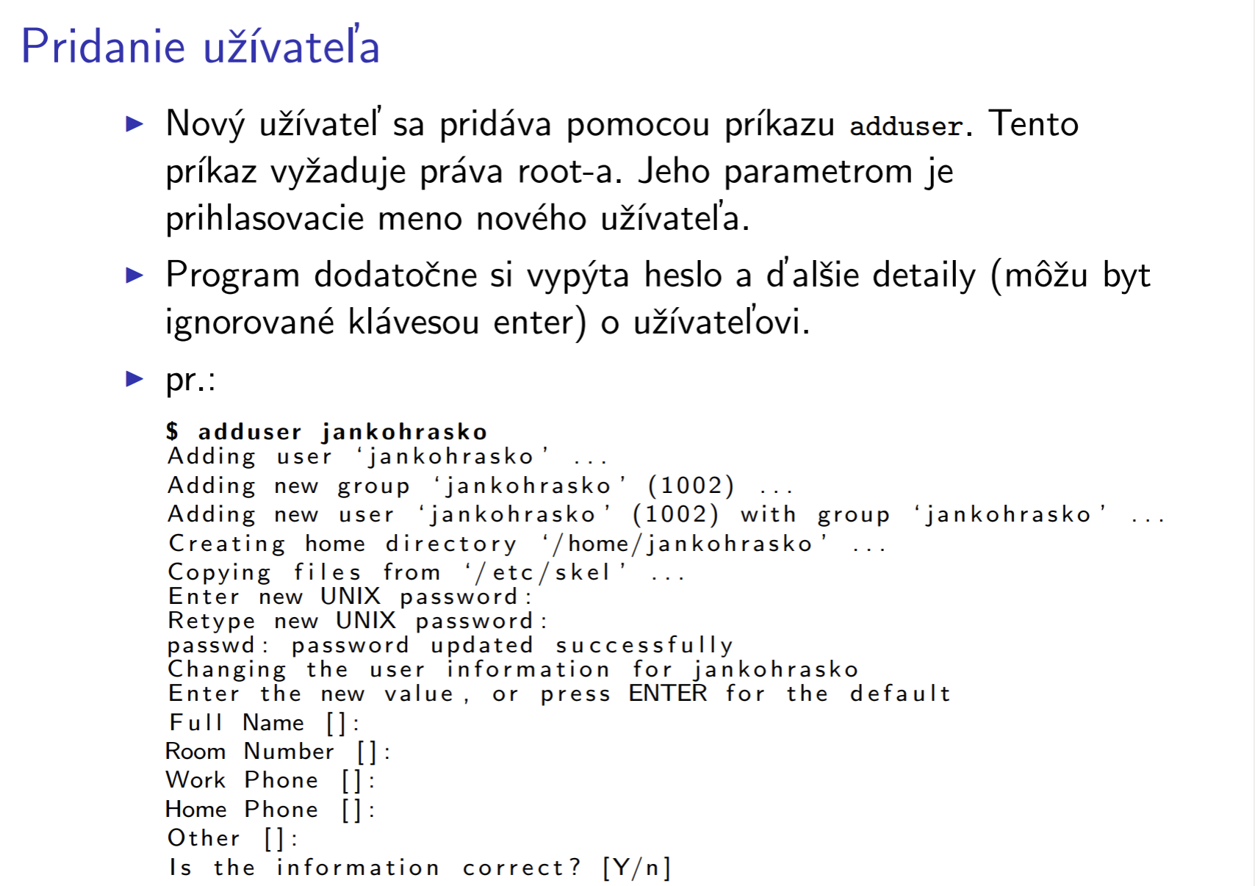

Slide 8
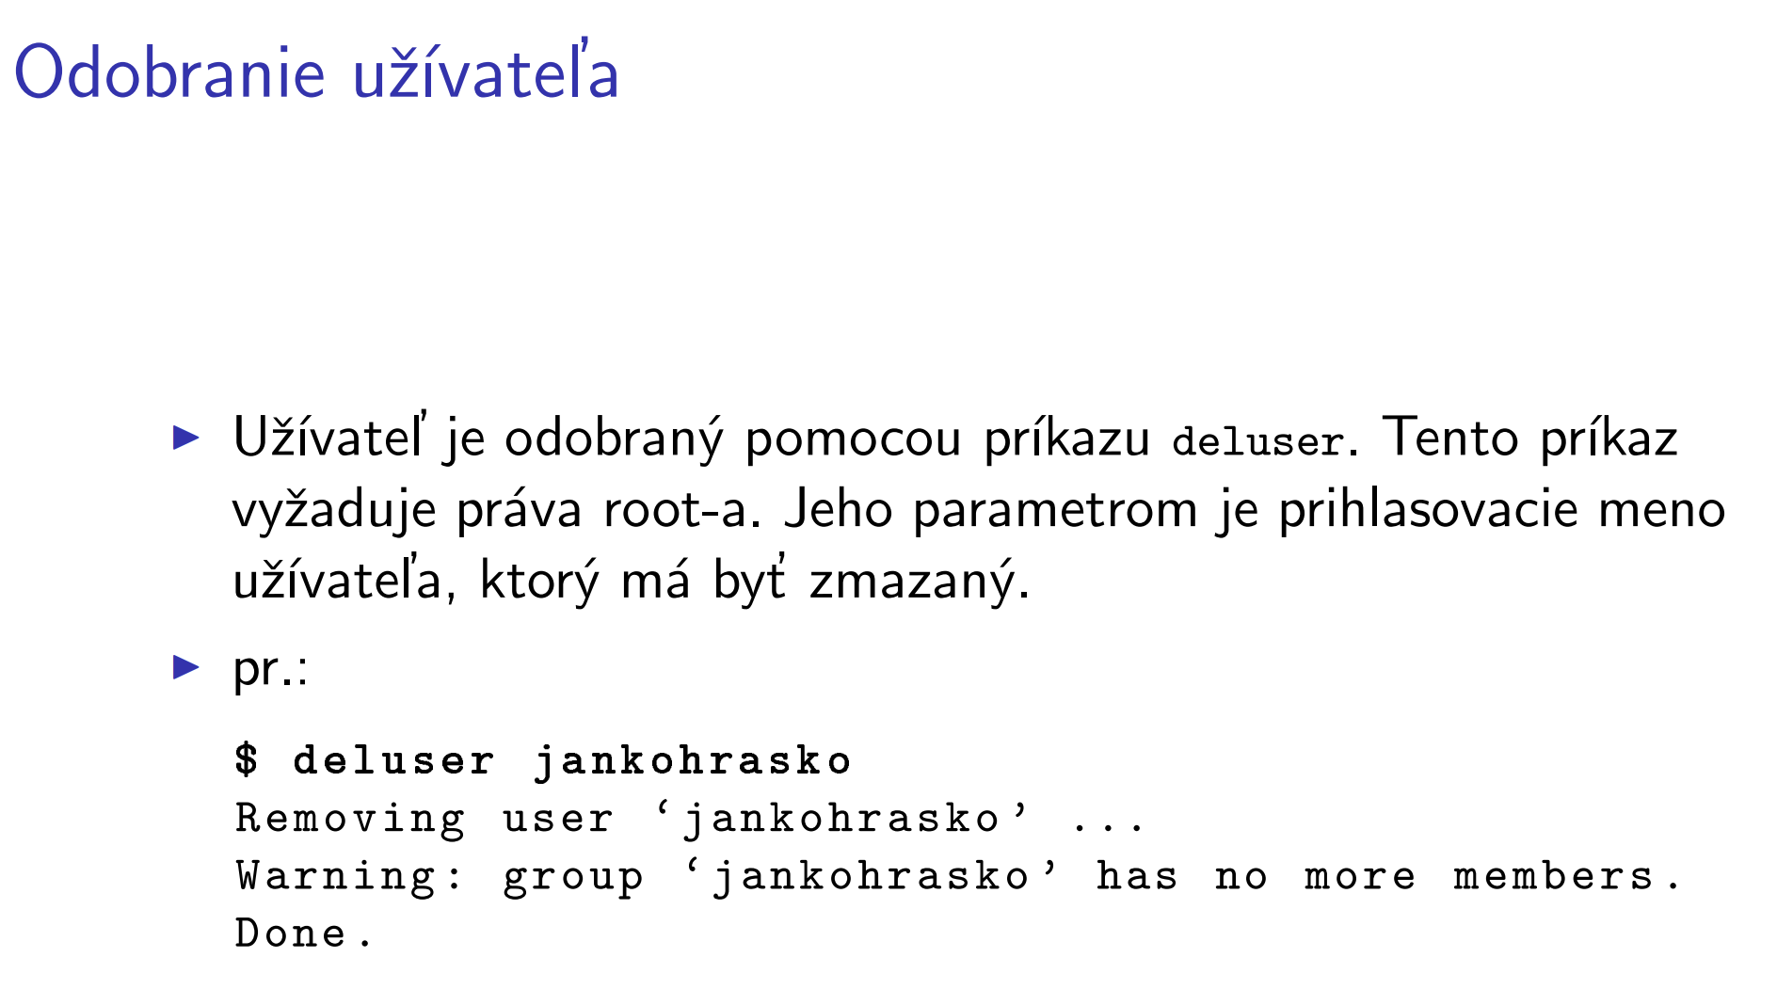

Slide 9
Gathering Login Session Info I.
particular identity of user includes:
username
group name
user ID
group ID
Linux keeps track of login session:
when user logs in
how long is user idle
where user logs in from

Slide 10
Gathering Login Session Info II.
to find out more info about identity, use the id command
$ id
uid=1000(mirek)gid=1000(mirek) groups=4(adm),100(users),1000(mirek)
other groups represents the permissions, that mirek has to access computer resources
newgrp - log in to a new group
newgrp users
groups - vypíše do ktorých skupín patríte
gpasswd - administer /etc/group and /etc/gshadow

Slide 11
Gathering Login Session Info III.
who am i exactly?
$ whoami
mirek

Slide 12
Gathering Login Session Info IV.
what groups I am in?
$ groups
mirek adm dialout cdrom plugdev users lpadmin netdev admin sambashare
what groups are other users in? $ groups luba
luba : users adm dialout fax cdrom tape audio dip video plugdev fuse netdev

Slide 13
Gathering Login Session Info V.
to see information about user's current login session, use the who command
$ who –H
NAME LINE TIME COMMENT
mirek tty1 Sep 7 19:41
who options
-H – adds header to output
-b – time of last system boot

Slide 14
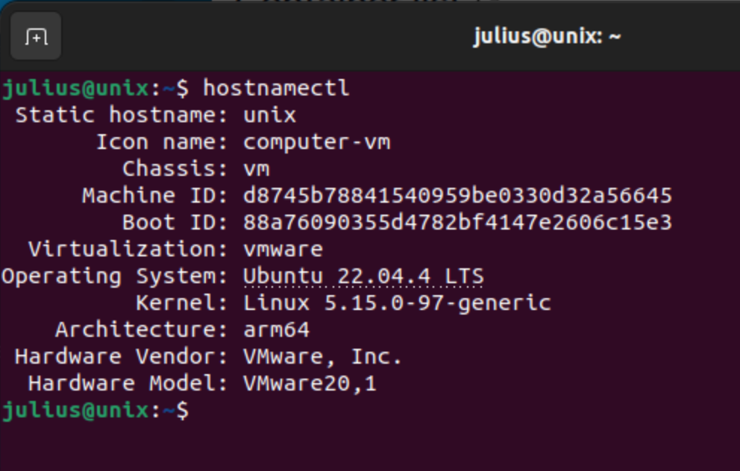
Gathering System Info
version of kernel
$ uname -a
last boot time
$ who -b
running runlevel
$ who -r
computer's uptime
$ uptime
Info about system / OS distrib
$ hostnamectl
lsb_release –a verzia ubuntu

Slide 15
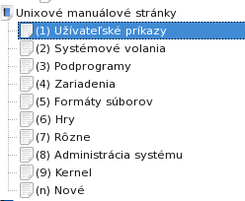
Help
man + názov príkazu
1 user commands, 2 system calls, 3 C library functions, 4 devices and special files, 5 file formats and conventions, 6 games a pod, 7 miscelaanea, 8 system administration tools and Deamons
man 3 clock
man 3p clock
man 8 clock
apropos oblasť ktorú hľadáme
apropos –s1 disk space (len príkazy)
whatis clock
Info clock
V grafickom režime yelp alebo khelpcenter
Alebo web a HOWTO, FAQ ...
Zrušenie podfarbenia man
julius@unix:~$ echo 'export PAGER=more' >> ~/.bashrc
julius@unix:~$ source ~/.bashrc

Slide 16
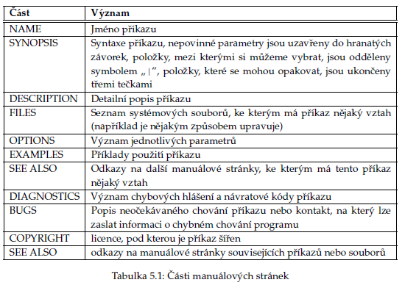
Help

Slide 17
Questions?

